Slide 1
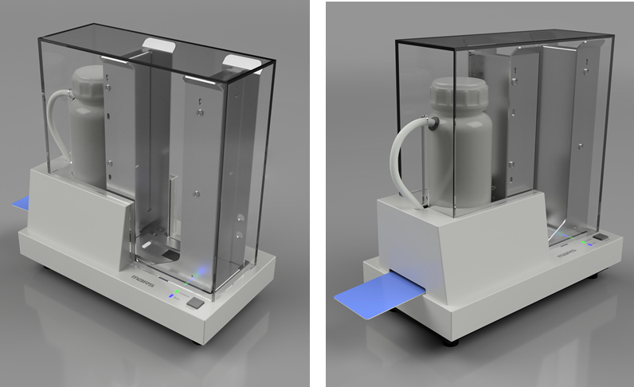
Card Sterilization Device Ideal for infection prevention Stock Card Cleaner – Model CL-76S
Compact | High-Speed Sterilization
CL-76S
Features
Acrylic cover is an optional item
Card Sanitizer
Easy to use. Simply set the card and press the start button to complete the sterilization process.
Because the CL-76S comes with a dispenser it’s possible to continuously clean up to 200 cards.
Specifications
External Dimensions | W145 × D255 × H253 [mm] / 1[kg]
Power Source | AC100 - 240[V]
Applicable Cards | 30mil ※10mil optional
Card Feeding | Discharge one-by-one from the dispenser
Disinfection Method | Special sterilization solution and cleaning pad
Accessories | Disinfectant solution (250mL) x 1 1 set of cleaning pads
Making the world cleaner

Slide 2
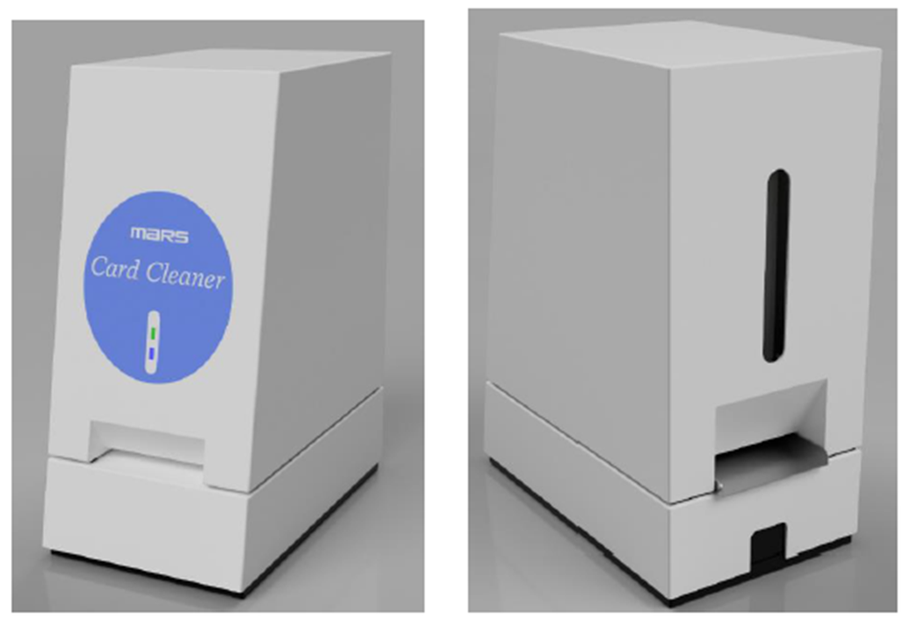
Card Sterilization Device Ideal for Infection Prevention Tabletop Card Cleaner – Model CL-76D
Compact | High-Speed Sterilization | Non-Contact Operation
CL-76D
Card Sanitizer
Features
Simply insert the card on the back of the machine to complete the sterilization process. Non-contact delivery. After inserting the card into the face of the machine, the cleaned card is returned from the front.
Specifications
External dimensions | W145 × D255 × H253 [mm] / 1[kg]
Power Source | AC100 - 240[V]
Applicable Cards | 10mil - 30mil ※10mil optional
Card Feeding | From Rear to Front Feed
Card Capacity | 200 cards
Disinfection Method | Special sterilization solution and cleaning pad
Accessories | Disinfectant solution (250mL) x 1 1 set of cleaning pads
Making the world cleaner

Slide 3
Card Sterilization Device Ideal for infection prevention Tabletop Card Cleaner – Model CL-76R
Compact | High-Speed Sterilization | Self-Service
CL-76R
Features
Card Sanitizer
Self-service card sterilization device. Disinfection is completed by simply inserting a card on the front of the machine.
Specification
External Dimensions | W145 × D255 × H253 [mm] / 1[kg]
Power Source | AC100 - 240[V]
Applicable Cards | 10mil - 30mil ※10mil optional
Card Feeding | Front Feed and Front Return
Disinfection Method | Special sterilization solution and cleaning pad
Accessories | Disinfectant solution (250mL) x 1 1 set of cleaning pads
販売元
Making the world cleaner

